Slide 1
Maximizing Profit of a flight company using HUI-Miner algorithm
Mentor :
Dr. DHARAVATH RAMESH
CSE Department
IIT(ISM) DHANBAD
Presentation by :
SHANTANU SARIN (15JE001824)
B.TECH CSE 5th Sem
AMAN RATHORE (15JE001292 )
CSE DUAL DEGREE 5th Sem

Slide 2
Origins of Data Mining
Draws ideas from machine learning/AI, pattern recognition, statistics, and database systems
Must address:
Enormity of data
High dimensionality of data
Heterogeneous, distributed nature of data
AI /
Machine Learning
Statistics
Data Mining
Database systems

Slide 3
Introduction
Data is produced at a phenomenal rate
Our ability to store has grown
Users expect more sophisticated information
How?
UNCOVER HIDDEN INFORMATION
DATA MINING

Slide 4
Why Data Mining
Credit ratings/targeted marketing:
Given a database of 100,000 names, which persons are the least likely to default on their credit cards?
Identify likely responders to sales promotions
Fraud detection
Which types of transactions are likely to be fraudulent, given the demographics and transactional history of a particular customer?
Customer relationship management:
Which of my customers are likely to be the most loyal, and which are most likely to leave for a competitor? :
Data Mining helps extract such information

Slide 5
Applications
Banking: loan/credit card approval
predict good customers based on old customers
Customer relationship management:
identify those who are likely to leave for a competitor.
Targeted marketing:
identify likely responders to promotions
Fraud detection: telecommunications, financial transactions
from an online stream of event identify fraudulent events
Manufacturing and production:
automatically adjust knobs when process parameter changes
Notes:
Any area where large amounts of historic data that if understood
better can help shape future decisions.

Slide 6
Applications (continued)
Medicine: disease outcome, effectiveness of treatments
analyze patient disease history: find relationship between diseases
Molecular/Pharmaceutical: identify new drugs
Scientific data analysis:
identify new galaxies by searching for sub clusters
Web site/store design and promotion:
find affinity of visitor to pages and modify layout

Slide 7
Association rules
T
Milk, cereal
Given set T of groups of items
Example: set of item sets purchased
Goal: find all rules on itemsets of the form a-->b such that
support of a and b > user threshold s
conditional probability (confidence) of b given a > user threshold c
Example: Milk --> bread
Purchase of product A --> service B
Tea, milk
Tea, rice, bread
cereal

Slide 8
Frequent pattern itemset mining
In an entire data base , this algorithm can provide an itemset/s having occurrence more than a min threshold provided.
Downward closure property is implemented to avoid computing all 2^n subsets of n items.

Slide 9
Apriori
Large Itemset Property:
Any subset of a large itemset is large.
Contrapositive:
If an itemset is not large,
none of its supersets are large.

Slide 10
When Frequent itemset mining fails ??
Suppose for salesman the most frequent item sold is bread(say 20/day) for a profit of Rs/2 per piece
He may also have sold 5 cakes each of which earned him Rs/30.
Using FIM output is Bread which earned him 20*2=Rs/.40 per day
Though cakes earned 30*5 = 150.
Thus frequency is not enough as a parameter.
Utility( freq * profit) should be considered as a whole.
This is HIGH UTILITY ITEMSET MINING

Slide 11
Need of HUI-Miner algorithm ?
Most existing algorithms generate candidate itemsets by overestimating their utilities.
However many are not high utility.
HUI-Miner used a utility-list structure to store both utility and info for pruning together.
This avoids costly generation of candidated & only single traversal of database is done.
Experimentally HUI-Miner outperforms most algorithms both in running time & memory consumption.

Slide 12
Diagram
transactions
High utility itemsets
Construct
utility list
HUI-Miner

Slide 13
Outline
Introduction
Problem Definition
Utility-List Structure
High Utility Itemset Miner
Experiment
Conclusion

Slide 14
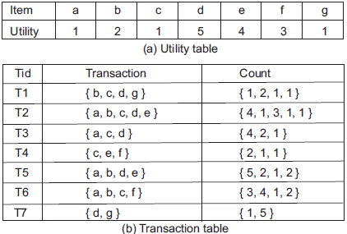
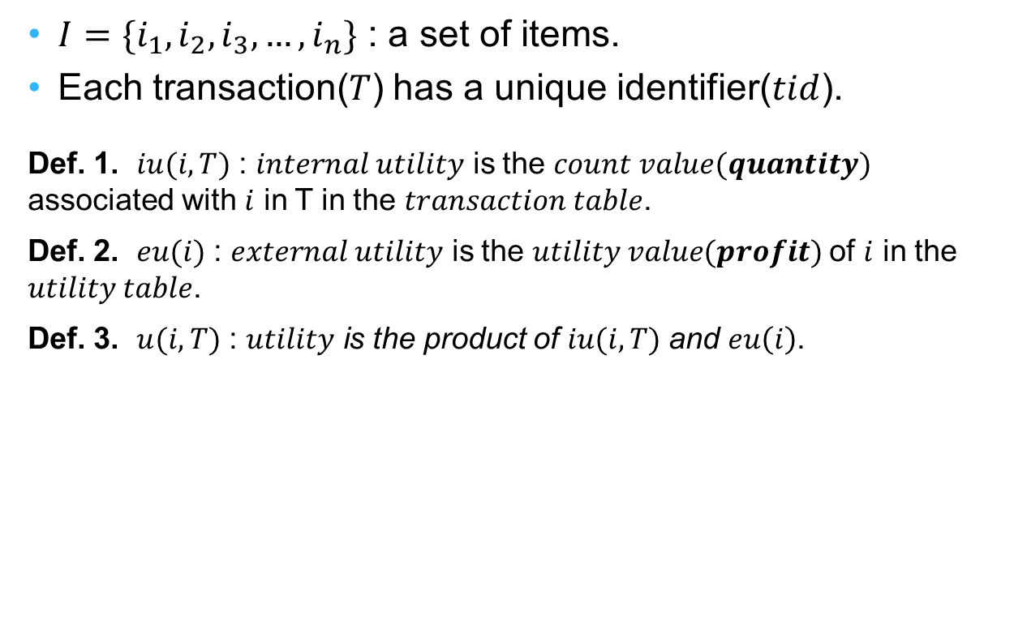
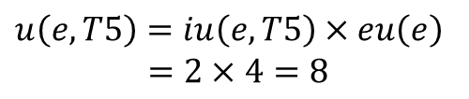

Problem Definition
$I=\{i_{1},i_{2},i_{3},…,i_{n}\}$: a set of items.
Each transaction($T$) has a unique identifier($tid$).
Def. 1.$iu(i, T)$: $internal utility$ is the $count value(quantity)$ associated with $i$ in T in the $transaction table$.
Def. 2.$eu(i)$: $external utility$ is the $utility value(profit)$of $i$ in the $utility table$.
Def. 3.$u(i, T)$: $utility$is the product of $iu(i, T)$and $eu\left(i\right)$.
Ex :
$$iu\left(e,T5 \right)=2$$
$$eu\left(e\right)=4$$
$$u\left(e,T5\right)=iu\left(e, T5\right)×eu\left(e\right) \\ =2×4=8$$

Slide 15



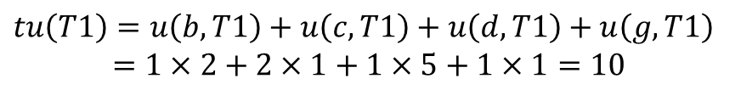
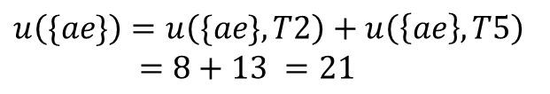
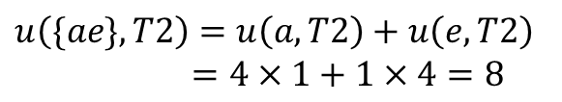
Def. 4.$u(X,T)$: The $utility$ of $itemset X$ in $transaction T$is the sum of the utilities of all the items in $X$in $T$, where $u\left(X,T\right)=\sum_{i∈X∧X⊆T}{u(i,T)}$.
Def. 5.$u(X)$: The $utility$ of $itemset X$is the sum of the utilities of $X$ in all the transactions in $DB$, where $u\left(X\right)=\sum_{T∈DB∧X⊆T}{u(X,T)}$.
Def. 6.$tu(T)$: The $utility$ of $transaction T$is the sum of the utilities of all the items in $T$, where $tu\left(T\right)=\sum_{i∈T}{u(i,T)}$.
Ex :
$$u\left(\{ae\},T2\right)=u\left(a,T2\right)+u\left(e,T2\right) \\ =4×1+1×4=8$$
$$u\left(\{ae\}\right)=u\left(\{ae\}, T2\right)+u\left(\left\{ae\right\},T5\right) \\ =8+13 =21$$
Ex :
$$tu\left(T1\right)=u\left(b,T1\right)+u\left(c,T1\right)+u\left(d,T1\right)+u\left(g,T1\right)$$ $=1×2+2×1+1×5+1×1=10$
$$Transaction Utility$$

Slide 16
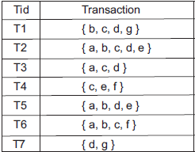


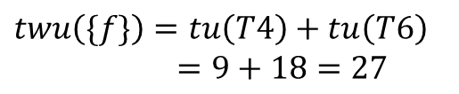

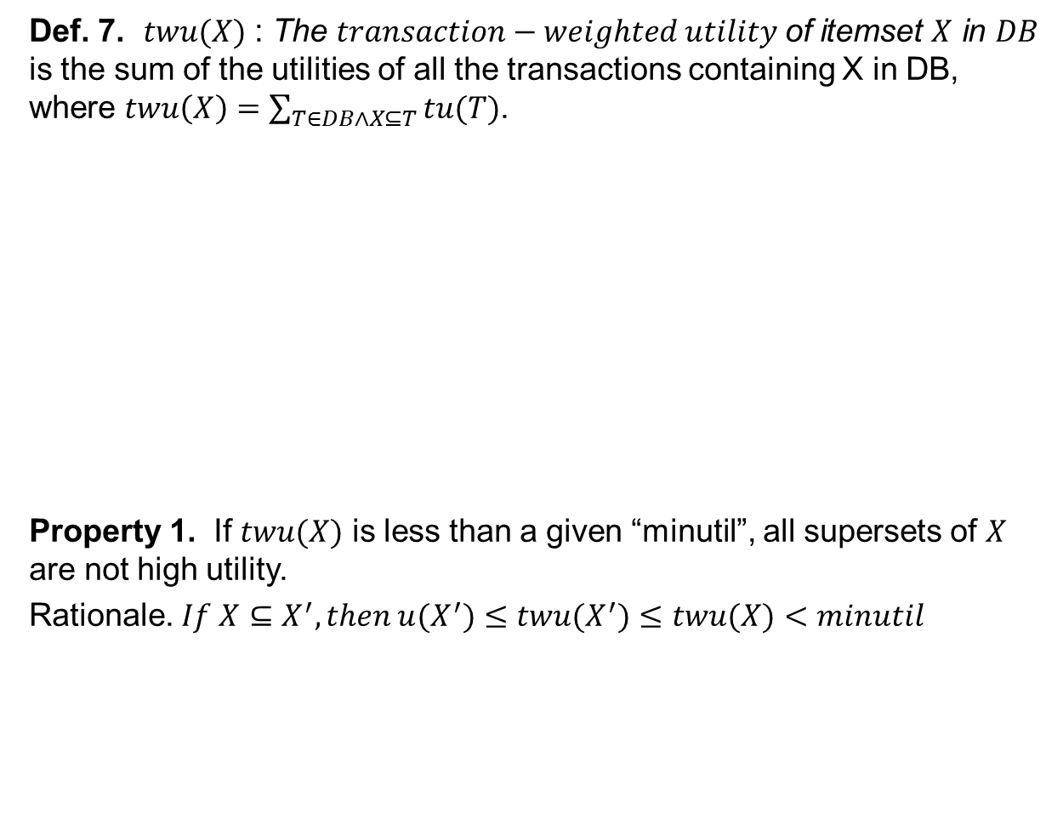
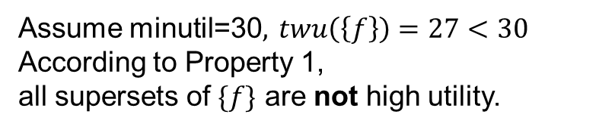
Def. 7.$twu(X)$: The $transaction−weighted utility$of itemset $X$ in $DB$ is the sum of the utilities of all the transactions containing X in DB, where $twu\left(X\right)=\sum_{T∈DB∧X⊆T}{tu(T)}$.
Property 1.If $twu(X)$ is less than a given “minutil”, all supersets of $X$ are not high utility.
Rationale. $If X⊆X^{′},then u(X^{′})≤twu(X^{′})≤twu(X)<minutil$
Ex :
$$twu\left(\{f\}\right)=tu\left(T4\right)+tu\left(T6\right) \\ =9+18=27$$
$$Transaction Utility$$
$$Transaction−Weighted Utility$$
Ex :
Assume minutil=30, $twu\left(\left\{f\right\}\right)=27<30$
According to Property 1,
all supersets of $\{f\}$ are nothigh utility.

Slide 17
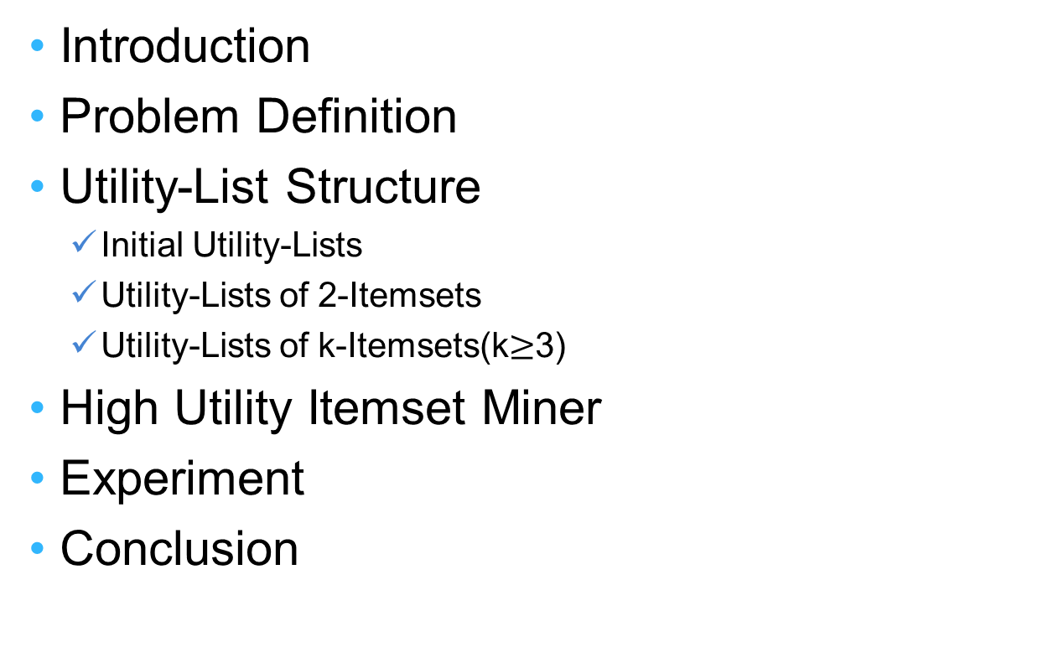
Outline
Introduction
Problem Definition
Utility-List Structure
Initial Utility-Lists
Utility-Lists of 2-Itemsets
Utility-Lists of k-Itemsets(k$≥$3)
High Utility Itemset Miner
Experiment
Conclusion

Slide 18

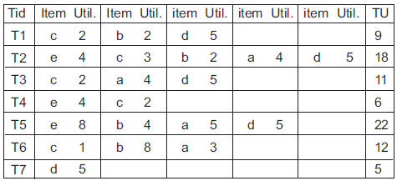

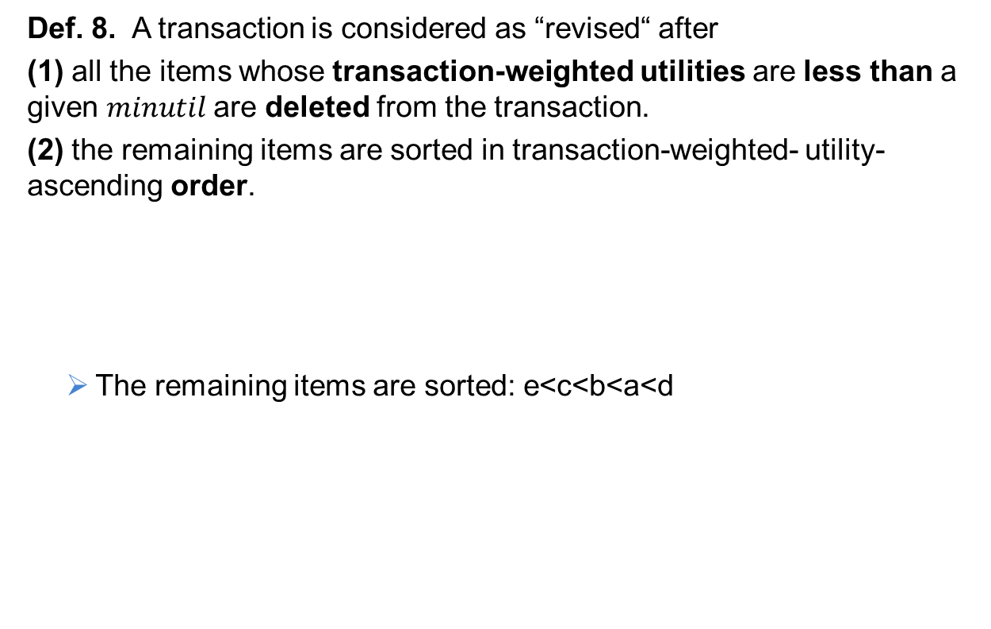


Initial Utility-Lists
Def. 8. A transaction is considered as “revised“ after
(1) all the items whose transaction-weighted utilities are less than a given $minutil$are deleted from the transaction.
(2) the remaining items are sorted in transaction-weighted- utility-ascending order.
The remaining items are sorted: e<c<b<a<d
Suppose $minutil=30$
$$Transaction−Weighted Utility$$
$$All Revised Transactions$$
Notes:
為何要要用twu由小而大排列

Slide 19
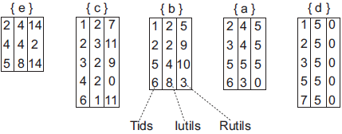






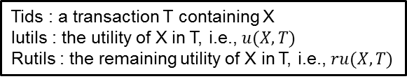
Def. 9$T/X$: The set of all the items after$X$ in $T$.
$X$ : an itemset, $T$ : a transaction (or itemset)
Def. 10.$ru(X,T)$: The $remaining utility$of itemset X in transaction T is the sum of the utilities of all the items in $T/X$ in $T$, where $ru\left(X,T\right)=\sum_{i∈(T/X)}{u(i,T)}$.
Ex :
$${T2}/{\left\{eb\right\}=\{ad\}}$$
$${T2}/{\left\{c\right\}=\{bad\}}$$
$$All Revised Transactions$$
Tids : a transaction T containing X
Iutils :the utility of X in T, i.e., $u(X, T)$
Rutils : the remaining utility of X in T, i.e., $ru(X,T)$
Ex :
$$X=\left\{c\right\} in T3$$
$$Iutil=u(X,T2)=2$$
$$Rutil=ru\left(X,T2\right)=$$ $u(a,T2)+u(d,T2)=9$
<3,2,9> is in the utility-list of {c}.
$$Initial Utility−Lists$$

Slide 20
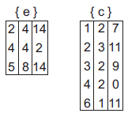




Utility-Lists of 2-Itemsets
No need for database scan.
identifying common
transactions
Utility-lists
of 2-itemset
$$Iutil=u\left(\left\{ec\right\},T2\right)$$
$$=4+3=7$$
$$Rutil=ru\left(\left\{ec\right\},T2\right)$$
$$=2+4+5=11$$
$$Iutil=u\left(\left\{ec\right\},T4\right)$$
$$=4+2=6$$
$$Rutil=ru\left(\left\{ec\right\},T4\right)$$
$$=0$$

Slide 21
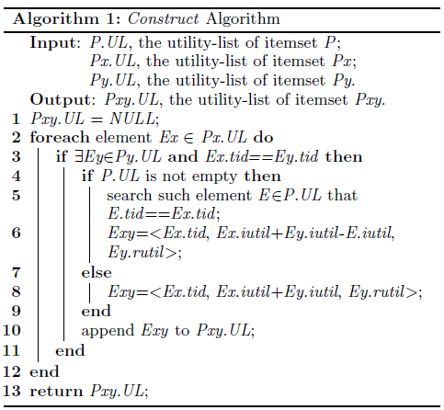








Utility-Lists of k-Itemsets
To construct the utility-list of k-itemset $\{i_{1}…i_{(k−1)}i_{k}\}$($k≥3$)
Intersect the utility-list of $\{i_{1}…i_{(k−2)}i_{k−1}\}$ and $\{i_{1}…i_{(k−2)}i_{k}\}$
Ex :
{$eba$}
(k$≥$3)
(k=2)

Slide 22
Outline
Introduction
Problem Definition
Utility-List Structure
High Utility Itemset Miner
Search space
Pruning Strategy
HUI-Miner Algorithm
Experiment
Conclusion

Slide 23
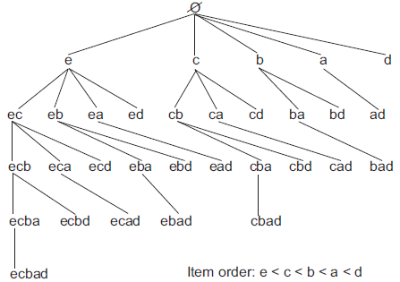

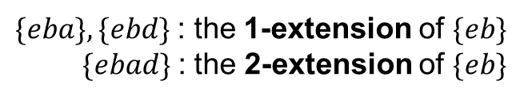
Search space
Set-Enumeration Tree
Def. 11. Given a set-enumeration tree, an itemset represented by a node is called an extension of an itemset represented by an ancestor node of the node. For an itemset containing $k$ items, its extension containing $(k+i)$items is called an $i$-$extension$of the itemset.
Ex :
$\{eba\},\{ebd\}$: the 1-extension of $\{eb\}$
$\{ebad\}$: the 2-extensionof $\{eb\}$
Def. 9
Property 2.If $X′$ is an extension of $X$, $(X′−X)=(X′/X)$
Rationale. Any extension of X is a combination of X with the item(s) after X.

Slide 24
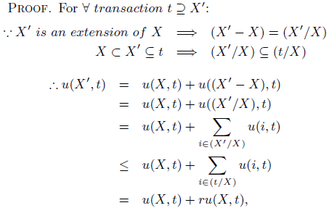

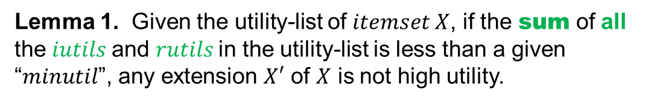
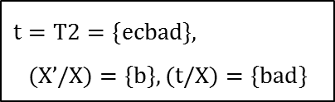

Pruning Strategy
Exhaustive search → Time consuming
Lemma 1.Given the utility-list of $itemset X$, if the sumof allthe $iutils$and $rutils$in the utility-list is less than a given “$minutil$”, any extension $X′$ of $X$ is not high utility.
$$Assume X=\left\{ec\right\}, X’=\{ecb\}$$
$$t=T2=\{ecbad\},$$
$$(X’/X)=\{b\}, (t/X)=\{bad\}$$
$$u\left(\left\{ecb\right\},T2\right)$$
$$=u(\{ec\},T2)+u(\{b\},T2)$$
$$≤u(\{ec\},T2)+u(\{bad\},T2)$$
$$=u(\{ec\},T2)+ru(\{ec\},T2)$$
Notes:
窮舉搜尋固然可以找到所有high utility itemsets，但是卻相當耗時的 因為在database內的item個數非常龐大，若item個數有n個，則窮舉會產生出二的n次方itemsets

Slide 25
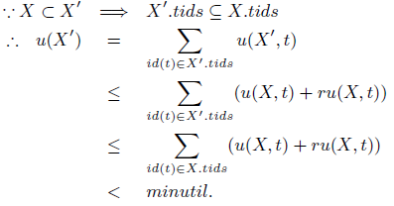





$id(t)$: the $tid$ of transaction $t$
$X.tids$: the $tid$set in the utility-list of $X$
$X′.tids$ : the $tid$set in the utility-list of $X$’
$$\left\{ec\right\}⊂\left\{ecb\right\}⇒\left\{T2\right\}⊆\{T2,t4\}$$
$$u\left(\{ecb\}\right)$$
$$=u\left(\left\{ecb\right\},T2\right)$$
$$≤u\left(\left\{ec\right\},T2\right)+ru(\left\{ec\right\},T2)$$
$$≤u\left(\left\{ec\right\},T2\right)+ru\left(\left\{ec\right\},T2\right)$$
$+u\left(\left\{ec\right\},T4\right)+ru(\left\{ec\right\},T4)$
$$<minutil$$
Ex :
Suppose $minutil=30$
The sum of all the
iutilsamdrutils
$⇒$7+6+11=24 < 30

Slide 26
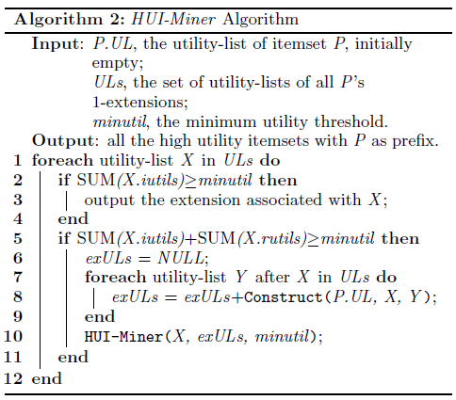

Slide 27
Application of HUI-Miner algorithm

Slide 28
How to deploy additional aircrafts to maximize profit/gain on diff routes.
Our algorithm provides all high utility itemsets above a min threshold.
We could also sort them in dec. order of utility so that we could deploy k no. of aircrafts b/w the top k routes.
This application helps the flight company owner to generate maximum profit via his newly deployed aircraft(s).

Slide 29
References
A Foundational Approach to Mining Itemset Utilities from Databases by Hong Yao, Howard J. Hamilton, and Cory J. Butz .

